Slide 1
Descriptive Statistics Graphing Techniques

Slide 2
Descriptive statistics
1. Measures of location (central tendency)
2. Measures of disperstion (variability)

Slide 3
1. Measures of Central Tendency
Measures that represent with a proper value the tendency of most data to gather around this value
Number of different measures of central tendency
the arithmetic mean
the median
the mode

Slide 4
The arithmetic mean
Notation
arithmetic mean ……
the sum of the values of a variable divided by the number of scores (by the sample size)

Slide 5
Properties of the arithmetic mean
it is expressed in the same unit of measure as the observed variable
it is the point in a distribution of measurements about which the sum of deviations are equal to zero
Note: deviation explains the distance and direction from a reference point – here the arithmetic mean, it is positive when the value is greater than the mean and negative when lower than the mean
3. the mean is very sensitive to extreme values

Slide 6
Personal income (thousands CZK)
No. |  |  | No.
1 | 13.2 | -12.62 | 9 | 16.4 | -9.42
2 | 13.5 | -12.32 | 10 | 17.2 | -8.62
3 | 14.0 | -11.82 | 11 | 19.0 | -6.82
4 | 14.5 | -11.32 | 12 | 25.8 | -0.02
5 | 14.5 | -11.32 | 13 | 27.0 | 1.18
6 | 15.2 | -10.62 | 14 | 35.0 | 9.18
7 | 15.6 | -10.22 | 15 | 35.5 | 9.68
8 | 16.2 | -9.62 | 16 | 120.5 | 94.68
 |  |  | ∑ | 413.1 | 0.00
thousands CZK

Slide 7
12 of 16 values are below the arithmetic mean, because of the highest value x₁₆=120.5 (directors income)
personal income is a commonly studied variable in which other measure of central tendency is preferred

Slide 8
Other measures of central tendency
The median….
The value above and below which one-half of the frequencies fall
n…odd number
median case number=(n+1)/2
n…even number
the arithmetic mean of the two middle values
Properties: Insensitive to extreme values

Slide 9
Other measures of central tendency
The mode….
The value that occurs with greatest frequency
for qualitative (nominal and ordinal) and quantitative discrete data
from a statistical perspective it is also the most probable value

Slide 10
Personal income (thousands CZK)
n=16… even number
No. |  | No.
1 | 13.2 | 9 | 16.4
2 | 13.5 | 10 | 17.2
3 | 14.0 | 11 | 19.0
4 | 14.5 | 12 | 25.8
5 | 14.5 | 13 | 27.0
6 | 15.2 | 14 | 35.0
7 | 15.6 | 15 | 35.5
8 | 16.2 | 16 | 120.5
the median the mode

Slide 11
Use of mean, median and mode
The arithmetic mean
member of mathematical system in advanced statistical analysis
preferred measure of central tendency if the distribution is not skewed
The median
when the distribution is skewed
The mode
whenever a quick, rough estimate of central tendency is desired

Slide 12
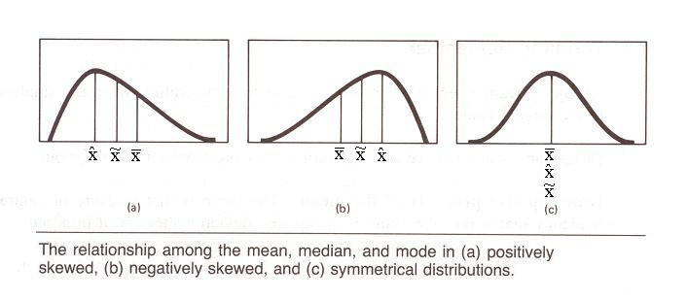
The mean, median, mode and skewness

Slide 13
2. Measures of Dispersion
to describe the spread of the data, its variation around a central value
we want to express the distance along the scale of values

Slide 14
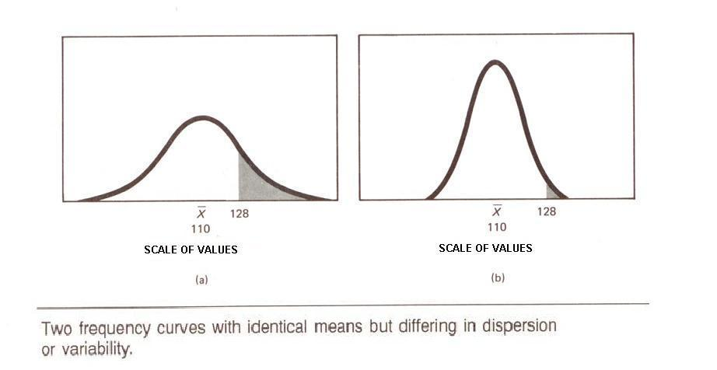

Slide 15
The Range….R
it is the distance between the largest and smallest value
R=x_{max}-x_{min}
it does not explain the variability inside the range !
very simple and straightforward measure of dispersion

Slide 16
The Variance…s²
it is an average squared deviation of each value from the mean
it is the sum of the squared deviations from the mean divided by n
when computing the variation based on sample we correct the calculation

Slide 17
Working formulas
For easier computation
Formula 1
Formula 2

Slide 18
the variance explains both
the variability of the values around the arithmetic mean
the variability among the values
difficult interpretation
(it is expressed in the squares of the unit of measure)

Slide 19
The Standard Deviation…s
it is the square root of variance
when computing the variation based on sample

Slide 20
Properties of the standard deviation
it is expressed in the same unit of measure as the observed variable
the size of the standard deviation is related to the variability in the values
the more homogeneous values, the smaller SD
the heterogeneous values, the larger SD
member of mathematical system in advanced statistical analysis (like the mean)

Slide 21
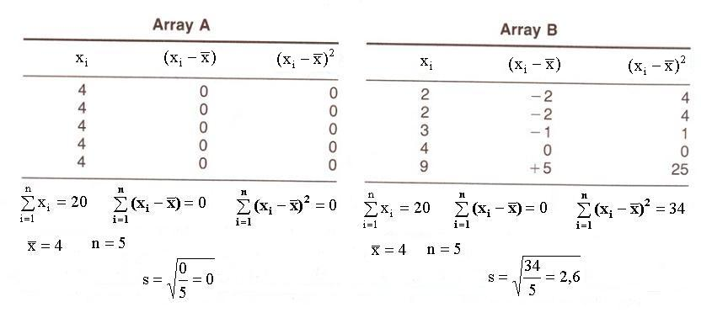
Two data sets with the same arithmetic mean and different SD

Slide 22
Example – Personal income (thousands CZK)
No.
1 | 13.2 | -12.62 | 159.2644
2 | 13.5 | -12.32 | 151.7824
… | … | … | …
16 | 120.5 | 94.68 | 8 964.3024
 |  | ∑ | 10 370.04
thousands CZK

Slide 23
Coefficient of Variation…V
the ratio of the standard deviation to the mean
often reported as a percentage (%) by multiplying by 100

Slide 24
it is a relative measure of dispersion
use when comparing two data sets with different units or widely different means
values higher than 50% indicate large variability

Slide 25
Example – Personal income (thousands CZK)
No.
1 | 13.2 | -12.62 | 159.2644
2 | 13.5 | -12.32 | 151.7824
… | … | … | …
16 | 120.5 | 94.68 | 8 964.3024
 |  | ∑ | 10 370.04

Slide 26
Summary: mean and variance
Non-weighted and weighted form
Mean
Non-weighted
Weighted
Variance
Non-weighted
Weighted

Slide 27
Summary: mean and variance
Non-weighted and weighted form example
The manager of the Bus station fast food wagon is interested in studying the typical number of customers who arrive at his wagon during lunch time. He observed 10 days and results are as follows:
4; 5; 1; 2; 3; 2; 2; 4; 3; 2
x_{i} | 1 | 2 | 3 | 4 | 5 | Total
n_{i} | 1 | 4 | 2 | 2 | 1 | 10
f_{i} | 0.1 | 0.4 | 0.2 | 0.2 | 0.1 | 1

Slide 28
Percentiles (Centiles)
value below which a certain percent of observations fall
scale of percentile ranks is comprised of 100 units
insensitive to extreme values

Slide 29
Deciles
divides a distribution into 10 equal parts
there are 9 deciles
D₁ – 1st decile
- 10 percent of values fall below it
D₉ – 9th decile
- 90 percent of values fall below it

Slide 30
Quartiles
divides a distribution into 4 equal parts
Q₁ - 25 percent of values fall below it
- 25th centile
Q₂ - 50 percent of values fall below it
- 50th centile
Q₃ – 75 percent fall below it
- 75th centile

Slide 31
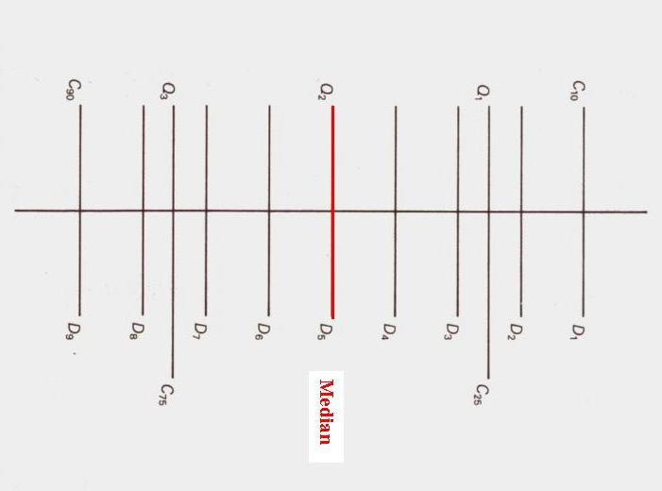

Slide 32
Graphing Techniques

Slide 33
Constructing graphs – Bar graph
x – axis: labels of categories
y – axis: frequency (relative frequency)
The height of each rectangle is the category`s frequency or relative frequency.

Slide 34
Arranging the graph
nominal variables – we can arrange the categories in any order:alphabetically, decreasing/increasing order of frequency
ordinal variables – the categories should be placed in their naturally occuring order

Slide 35
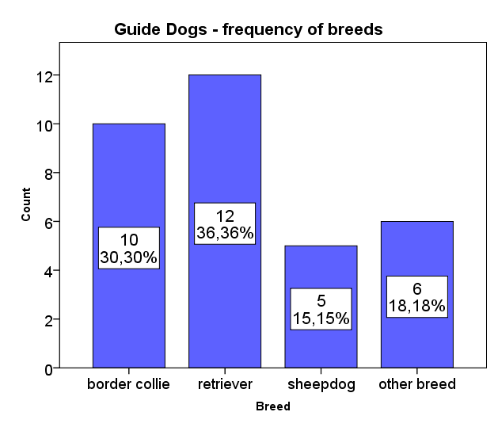

Slide 36
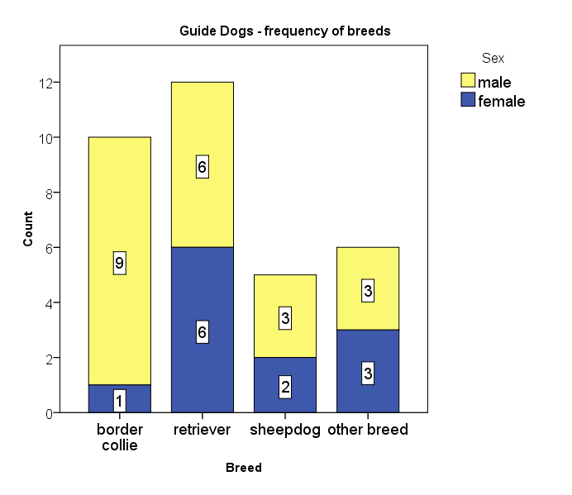

Slide 37
Constructing graphs – Pie graph
Pie chart – a circle divided into sectors
each sector represents a category of data
the area of each sector is proportional to the frequency of the category

Slide 38
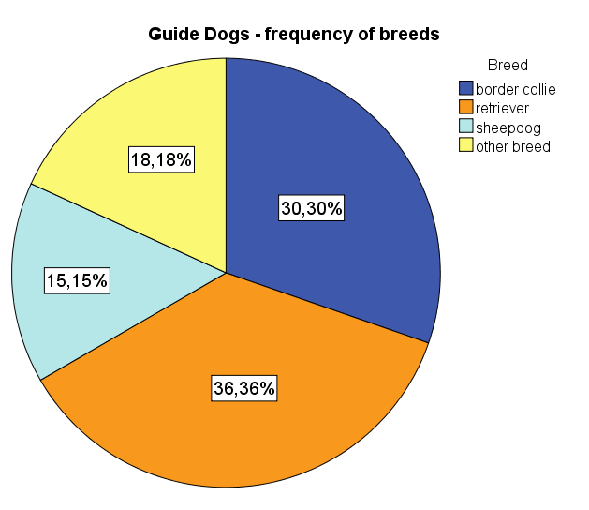

Slide 39
Constructing graphs – Histogram
bar graph for quantitative data
values are grouped into intervals (classes)
constructed by drawing rectangles for each class of data
the height of each rectangle is the frequency of the class
the width of each rectangle is the same

Slide 40
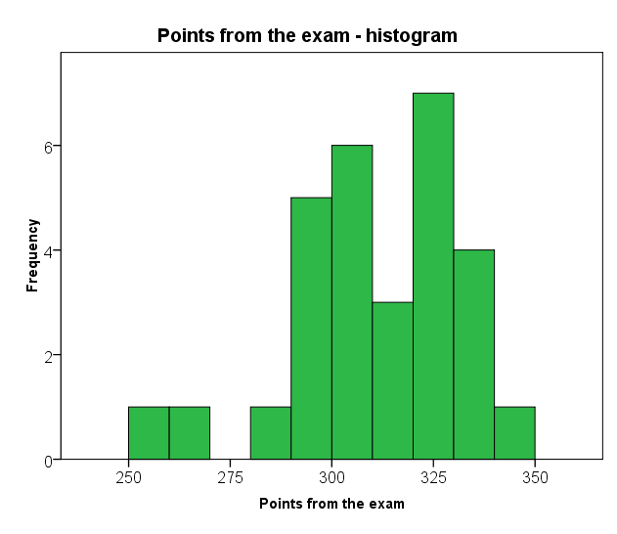

Slide 41
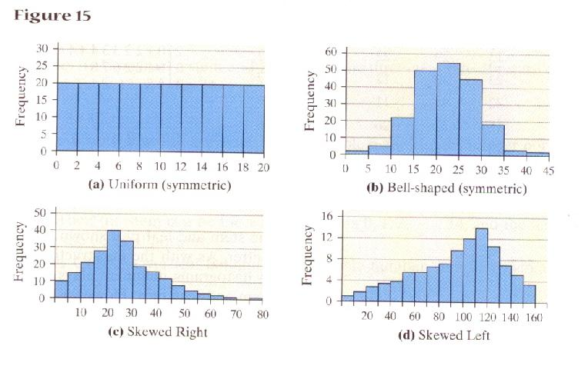
Histogram

Slide 42
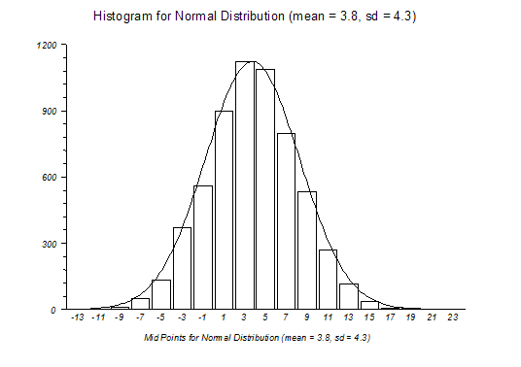

Slide 43
Constructing graphs – Boxplot
box-and-whisker diagram
five number summary

Slide 44
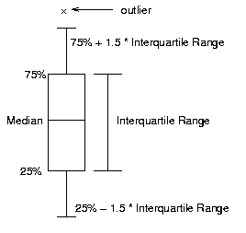
Boxplot
Q₃
Q₂
Q₁

Slide 45
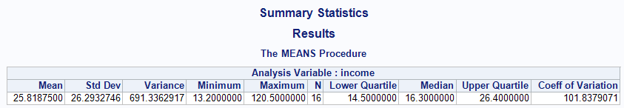
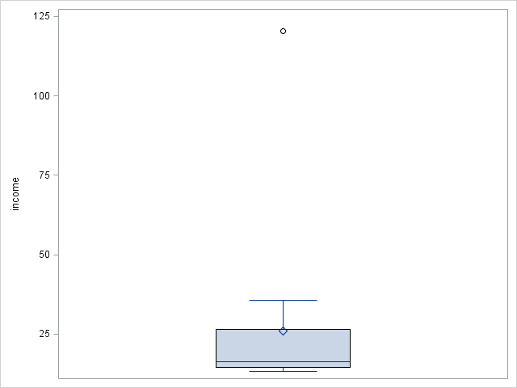
Example – personal income

Slide 46
Control questions
What are measures of location?
What is advantage of median in comparison with mean?
What are measures of variation?
What is five-number summary?
What shows Box plot?
What is outlier? How it is measured?
When we use weighted form of descriptive measures?

